Slide 1
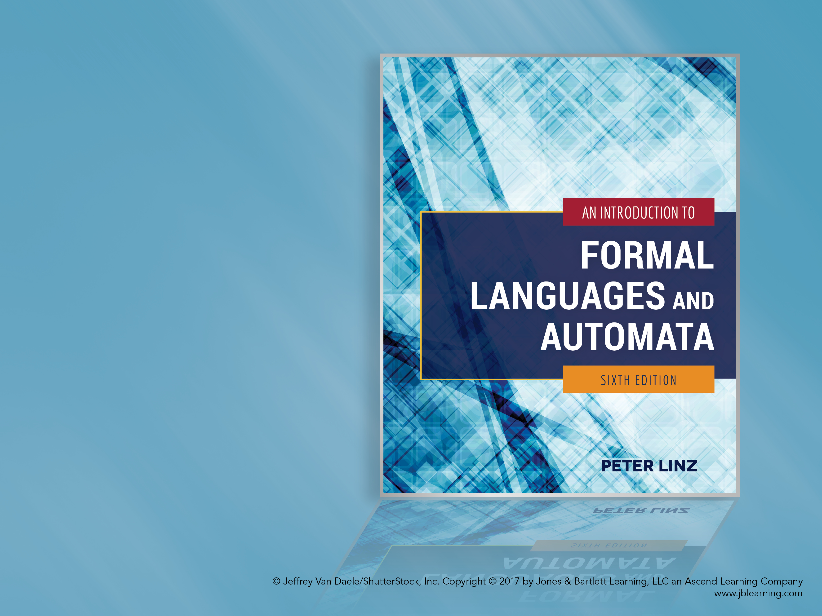
Chapter 4
PROPERTIES OF REGULAR LANGUAGES

Slide 2

Learning Objectives At the conclusion of the chapter, the student will be able to:
State the closure properties applicable to regular languages
Prove that regular languages are closed under union, concatenation, star-closure, complementation, and intersection
Prove that regular languages are closed under reversal
Describe a membership algorithm for regular languages
Describe an algorithm to determine if a regular language is empty, finite, or infinite
Describe an algorithm to determine if two regular languages are equal
Apply the pumping lemma to show that a language is not regular

Slide 3
Closure Properties
Theorem 4.1 states that if L₁ and L₂ are regular languages, so are the languages that result from the following operations:
L₁ ∪ L₂
L₁ ∩ L₂
L₁L₂
L₁
L₁*
In other words, the family of regular languages is closed under union, intersection, concatenation, complementation, and star-closure.

Slide 4
Proof of the Closure Properties
Since L₁ and L₂ are regular languages, there exist regular expressions r₁ and r₂ to describe L₁ and L₂, respectively
The union of L₁ and L₂ can be denoted by the regular expression r₁ + r₂
The concatenation of L₁ and L₂ can be denoted by the regular expression r₁r₂
The star-closure of L₁ can be denoted by the regular expression r₁*
Therefore, the union, concatenation, and star-closure of arbitrary regular languages are also regular

Slide 5
Proof of the Closure Properties (cont.)
To prove closure under complementation of an arbitrary regular language L₁, assume the existence of a dfa M that accepts L₁
A dfa M’ that accepts the complement of L₁ can be constructed as follows:
M’ has the same states, alphabet, transition function, and start state as M
The final states in M become non-final states in M’, while the non-final states in M become final states in M
Since M’ accepts precisely the strings that M rejects, and M’ rejects precisely the strings that M accepts, then M’ accepts the complement of L₁, which is therefore shown to be regular

Slide 6

Proof of the Closure Properties (cont.)
To prove that the intersection of two regular languages L₁ and L₂ is also regular, two basic approaches exist:
Given a dfa M₁ that accepts L₁ and a dfa M₂ that accepts L₂, construct a new dfa M’ with states and transition function resulting from a combination of the states and transition functions from M₁ and M₂
Use DeMorgan’s law to show that the intersection of L₁ and L₂ can be obtained by applying union and complementation:
Since the union and complementation operations have been shown to produce regular languages, the intersection of L₁ and L₂ must also produce a regular language

Slide 7
Closure under Reversal
Theorem 4.2 states that if L is a regular language, so is L^{R}
To prove closure under reversal, we can assume the existence of a nondeterministic finite automaton M with a single final state that accepts L
Given the transition graph for M, to construct a nfa M^{R} that accepts L^{R}:
The start state in M becomes the final state in M^{R}
The final state in M becomes the start state in M^{R}
The direction of all transition edges in M is reversed

Slide 8
Elementary Questions about Regular Languages
Given a regular language L and an arbitrary string w, is there an algorithm to determine whether or not w is in L?
Given a regular language L is there an algorithm to determine if L is empty, finite, or infinite?
Given two regular languages L₁ and L₂, is there an algorithm to determine whether or not L₁ = L₂ ?

Slide 9
A Membership Algorithm for Regular Languages
Theorem 4.5 confirms the existence of a membership algorithm for regular languages
To determine if an arbitrary string w is in a regular language L, we assume the existence of a standard unambiguous representation of L
Given a standard representation of L, construct a dfa to accept L
Simulate the operation of the dfa while processing w as the input string
As previously stated, if the machine halts in a final state after processing w, then w is in L

Slide 10
Determining Whether a Regular Language is Empty, Finite, or Infinite
Theorem 4.6 confirms the existence of an algorithm to determine if a regular language is empty, finite, or infinite
Given the transition graph of a dfa that accepts L,
If there is a simple path from the start state to any final state, L is not empty (since it contains, at least, the corresponding string)
If a path from the start state to a final state includes a vertex which is the base of some cycle, L is infinite (otherwise, L is finite)

Slide 11
Determining Whether Two Regular Languages are Equal
For finite languages, equality could be determined by performing a comparison of the individual strings
More generally, theorem 4.7 confirms the existence of an algorithm to determine if two regular languages L₁ and L₂ are equal:
Define the language L = (L₁ ∩ L₂) ∪ (L₁ ∩ L₂)
By closure, L is regular, so we can construct a dfa M to accept it, and by theorem 4.6, we can determine whether L is empty
L₁ and L₂ are equal if and only if L is empty

Slide 12
Identifying Nonregular Languages
Although regular languages can be infinite, their associated automata have finite memory and are therefore incapable of accepting many languages
To show that a language is not regular, two basic approaches exist:
Use the pigeonhole principle to construct a proof by contradiction
Use a pumping lemma for regular languages

Slide 13
Basis for the Pumping Lemma
The transition graph for a regular language has certain properties:
If the graph has no cycles, the language is finite
If the graph has a nonempty cycle, the language is infinite
If the graph has such cycle, the cycle can either be skipped or repeated an arbitrary number of times, so if the cycle has label v and if the string w₁vw₂ is in the language, so are the strings w₁vvw₂, w₁vvvw₂, etc.
If such a cycle exists in a dfa with m states, the cycle must be entered by the time m symbols have been processed
As a basis for the pumping lemma, we observe that given a language L, if any string in L does not satisfy these properties, L is not regular

Slide 14
A Pumping Lemma for Regular Languages
Theorem 4.8: Given an infinite regular language L, every sufficiently long string w in L can be broken into three parts xyz such that
|y| > 0 and |xy| ≤ m (where m is an arbitrary integer ≤ |w|)
An arbitrary number of repetitions of y yields another string in L
The middle section, y, is said to be “pumped” to generate additional strings in L
The pumping lemma can be used to show that, by contradiction, a certain language is not regular

Slide 15
Applying the Pumping Lemma to Show that a Language is not Regular
The proof is similar to a game in which our goal is to show that a language L is not regular, while an opponent maintains the opposite:
The opponent picks m
We pick a string w in L so that |w| ≥ m
The opponent chooses the decomposition xyz, subject to |y| > 0 and |xy| ≤ m, in a way that makes it hard to establish a contradiction
We try to pick a number of repetitions i, such that xy^{i}z is not in L
In general, we try to establish a strategy that allows us to show a contradiction regardless of the choices made in steps 1 and 3.

